Slide 1
Analytical Reasoning
Analytical Reasoning forms an important part of generally all Campus Placement Test. The questions in this section can either test analytical or logical reasoning.

Slide 2
PURPOSE

Slide 3
General Overview
The thinking process associated with such problems resembles solving a case, wherein the clues here are in the form of certain conditions, which may or may not be mutually exclusive.
The best way to get a hang of these problems is to work on them continuously
Notes:
DEFINITION of 'Mutually Exclusive' A statistical term used to describe a situation where the occurrence of one event is not influenced or caused by another event. In addition, it is impossible for mutually exclusive events to occur at the same time.

Slide 4
General Overview
Initially, they may deter you but once the student follows the rules given below and solves many problems, it will appear simple.

Slide 5
Suggestive Methodology
The methodology for solving such problems is only suggestive and the student can use his own discretion to solve it in an easier fashion.

Slide 6
Guiding Rules
Read, Read, and Read:
Reading the problem and its conditions is a pre-requisite. The student has to spend sometime reading and analyzing the statements.
Read the conditions carefully. Please don’t over-read into the conditions and statements.
Notes:
Over read: Reading quickly

Slide 7
Guiding Rules (Cont)
Identify the most important condition
Since the conditions are not given in any specific order, the student has to peruse through all of them and identify the key condition, which will provide the platform from where the problem can be solved.
If there are any restrictions in the problem, like for example, one of the elements has always to be at one place then start by putting that element there.
In case of ordering problems (wherein an order of the elements has to be ascertained), this becomes especially important.

Slide 8
Guiding Rules (Cont)
Picturize the information.
If, for example, the problem deals with 5 people standing at a bus stop, the student must be able to juxtapose it in his analysis.
Since there wont be sufficient place to work out these kinds of problems, picturization helps in arranging the information.
Notes:
place or deal with close together for contrasting effect.

Slide 9
Guiding Rules (Cont)
Organise the information.
Once the student has an idea of the problem, he has to organize the information in an easily comprehensible manner, i.e. he should try to associate it with whatever he feels comfortable.
The student should put every bit of detail on paper, say, make notes.
Some ways of organizing information are Grids/Tables and Symbols/Notations

Slide 10
Guiding Rules (Cont)
Elimination of Answer choices.
Some of the above rules do help one in eliminating answer choices.
It is generally not advisable in case of AR to start off by eliminating choices.
As you will see, many problems require a bottom-up approach, but, that is only after a careful perusal and analysis of the conditions.
Eliminate choices when the conditions are insufficient to answer the questions.
Notes:
Definition of bottom-up :from the lowest level of a hierarchy or process to the top: a bottom-up approach to corporate decision-making.

Slide 11
Guiding Rules (Cont)
Be careful of the language used.
Certain words or phrases are oft-repeated and these can well form important clues in framing the solution.

Slide 12
Conclusion of Guiding Rules
As mentioned above, conditions are a set of clues, which when analyzed, provide the solution for the problem.
These conditions cannot be violated and all these conditions have to be analyzed before attempting any question relating to the problem.
These conditions are not necessarily in order and therefore, it becomes imperative for the student to go through all of them before identifying the important ones.

Slide 13
Type I
INTRODUCTION
These are problems, which require the identification of a particular order or a schedule.
It consists of a few conditions, from which the order has to be identified.
These problems may deal with scheduling a program over a time period, say a week or an year.
Other variants of this game include
Identifying people staying in an apartment complex
Ordering of books in a shelf etc.

Slide 14
Type I (Cont)
GENERAL INSTRUCTION:
Following the guiding rules in previous slides, make a primary structure based on conditions given only. To make primary structure you need not to read questions.
Stronger and more comprehensive primary structure will result into less work to solve questions individually.

Slide 15
Example:Type I
A TV channel is going to telecast 6 soppy soaps over the week – Sob, Cry, Weep, Wail, Lament and Moan. One of these will be telecast each day from Monday to Saturday, with Sunday being a FunDay. The conditions specified by the Boss are as follows:
Sob must be telecast earlier in the week than Lament.
Weep must be telecast on Tuesday
Wail must be telecast on the day immediately before or immediately after the day on which Cry is telecast

Slide 16
Example:Type I (Cont)
Q 1. If Cry is telecast on Thursday, the earliest day on which Lament can be featured is
Monday b) Tuesday c) Wednesday d) Friday
e) Saturday
Q 2. If Moan is to be telecast on Friday, Sob must be telecast on
a) Monday b) Tuesday c) Wednesday d) Thursday
e) Saturday

Slide 17
Example:Type I (Cont)
Q 3. If Wail is to be featured on Thursday, the latest day on which Sob can be telecast is
a) Monday b) Tuesday c) Wednesday d) Friday e) Saturday
Q4. Which of the following soaps can be telecast on Monday?
a) Cry b) Moan c) Lament d) Weep e) Wail

Slide 18
Example:Type I (Cont)
Q 5. If Moan is to be telecast on Thursday, which of the following is true?
a) Sob must be telecast on Wednesday
b) Cry must be telecast on Saturday
c) Wail must be telecast exactly two days after Lament is telecast
d) Lament must be telecast on Wednesday
e) Lament must be telecast later in the week than Moan
Q6. If Moan is to be telecast on Friday, what is the total number of acceptable schedules available to
the TV channel?
a) 1 b) 2 c) 3 d) 4 e) 5

Slide 19
Solution/Discussion
It is imperative in these kinds of ordering problems that we begin with conditions that fix the exact position of one or more elements, and then work towards narrowing the possibilities for other elements.
When the order cannot be determined by the condition, then, attack the questions and proceed with eliminating choices.

Slide 20
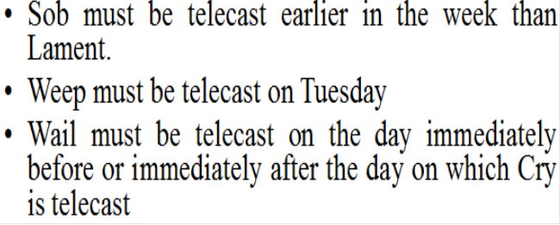
Solution/Discussion (cont)
There are 3 conditions, of which, the second condition that Weep should be telecast on Tuesday can be considered to be the important condition since it provides an ideal base to work the problem.

Slide 21
Solution/Discussion (cont)
The first condition suggests that Sob can be telecast on any day except Saturday, and Lament can be telecast on any day except Monday. Since Tuesday is already ruled out, the days of telecast for these two soaps are down to four.

Slide 22
Solution/Discussion (cont)
From the third condition, we can ascertain that Cry cannot be telecast on Monday because Weep is to be telecast on Tuesday. Therefore, Cry can be telecast on any day from Wednesday to Saturday.

Slide 23
Solution/Discussion (cont)
PRIMARY STRUCTURE
Let us now make a table to help organize this information
We can proceed in the following manner
Calculations
Monday: No Lament and Cry….so it’s either Sob, Wail or Moan (Cond 1&3)
Wednesday to Friday: All except Weep (Cond 2)
Saturday: All except Weep and Sob (Cond 1&2)
Days | Mon | Tue | Wed | Thir | Fri | Sat
Soaps |  | Weep

Slide 24
S No 1
Q 1. If Cry is telecast on Thursday, the earliest day on which Lament can be featured is
a) Monday b) Tuesday c) Wednesday d) Friday e) Saturday

Slide 25
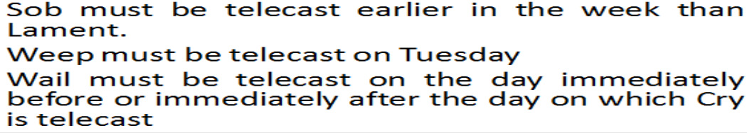
S.No 2
Q 2. If Moan is to be telecast on Friday, Sob must be telecast on a) Monday b) Tuesday c) Wednesday d) Thursday e) Saturday

Slide 26
S.No3
Q 3. If Wail is to be featured on Thursday, the latest day on which Sob can be telecast is
a) Monday b) Tuesday c) Wednesday d) Friday e) Saturday

Slide 27
S.No 4
Q4. Which of the following soaps can be telecast on Monday?
a) Cry
b) Moan
c) Lament
d) Weep
e) Wail
From our earlier calculation, we can easily say that Moan is the only soap, among the answer choices, that can be telecast on Monday.

Slide 28
S.No 5
Q 5. If Moan is to be telecast on Thursday, which of the following is true?
a) Sob must be telecast on Wednesday b) Cry must be telecast on Saturday c) Wail must be telecast exactly two days after Lament is telecast d) Lament must be telecast on Wednesday e) Lament must be telecast later in the week than Moan

Slide 29
S.No 5 (Cont)
Sob must be telecast on Wednesday: If Sob is telecast on Wednesday, Lament will have to be telecast
on wither Friday or Saturday, which is not possible because Cry and Wail have to be telecast on
consecutive days. Therefore, this is untrue.
Cry must be telecast on Saturday: Cry can be telecast on Friday or Saturday. Though this is not entirely untrue, it is an option we should keep in mind till we arrive at the exact answer.

Slide 30
S.No 5 (Cont)
Wail must be telecast exactly two days after Lament is telecast. Since, in this case, Lament has to be telecast on Wednesday, Wail can be telecast either on Friday or Saturday, i.e. either 2 or 3 days after lament is telecast. So, even this option is not entirely untrue and should be kept in abeyance till we arrive at the final answer.

Slide 31
S.No 5 (Cont)
Lament must be telecast on Wednesday: From the argument for the earlier answer choices, we find
that Lament has to be telecast on Wednesday alone.
Lament must be telecast later in the week than Moan: this is not possible since Cry and Wail have to be telecast on consecutive days and only Friday and Saturday are available for them. Therefore, after examining the answer choices, we find that the correct answer is (d).

Slide 32
S.No 6
Q6. If Moan is to be telecast on Friday, what is the total number of acceptable schedules available to the TV channel?
a) 1 b) 2 c) 3 d) 4 e) 5

Slide 33
Type II
Cyclic Order/Round Table
In this game, there are a few people sitting around a table or a few objects, kept in a cyclic order.
The basic theme here is to identify, from the conditions, the exact placement of a person/objects around the table/circular path.

Slide 34
Type II (cont)
This is a very simplistic version of the problem. The best and the simplest method to solve round-table problems is to start by drawing a table and seating the students according to the conditions.
Questions generally relate to the seating arrangement around the table and therefore are very simple. For example, Who sits in front of B? Who faces B if A and D swap places?

Slide 35
Example Type II
There are six people, A, B, C, D, E and F sitting around a table.
1. The person sitting to the left of A faces D.
2. B and E sit on either side of C
3. A and B do not face each other.

Slide 36
SOLVING SUCH PROBLEMS
Key to solve such problems is that analyze all conditions taken one at a time.
Remember, Key condition should be taken first of all for analysis.

Slide 37
Solution/Discussion
Analyzing First Condition
For example, from the first condition, by seating A at the top of the table, we can ascertain the exact seating position of D.

Slide 38
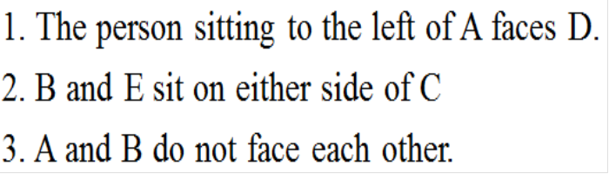
Solution/Discussion (Cond)
Analyzing Second Condition in Addition to First Condition
Since the identity of the person seated next to A cannot be ascertained with one condition alone, we move on to the second condition. After analyzing the second condition along with the diagram above, we can ascertain the exact seating position of E, as illustrated by the following diagram.

Slide 39
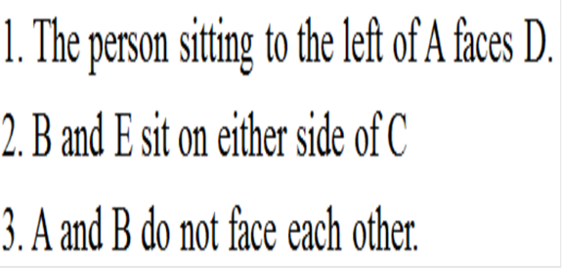
Solution/Discussion (Cond)
Analyzing 3rd Condition in Addition to 1st & 2nd Condition
The third condition that A and B do not face each other means that A is sitting to the left of A and facing D and E is facing A (from the second condition above). And therefore the final seating arrangement would like this

Slide 40
Type III
Different Strokes/Multi-dimensional Scheduling
This game is a variant of the above, with more number of elements.
One thing to remember, the more the conditions, the easier it is to solve the problem.
There are many variants of this game, like people standing in a bus-stop/railway station etc.

Slide 41
Example Type III
There are 5 houses coloured Red, Green, Black, White and Blue in a row. Each of the houses is occupied by bachelors of different professions (Singer, Accountant, consultant, Software engineer and lawyer) and each of them has a different vehicle in which to commute to office. The colour of the vehicle is different from not only that of his house but also of his neighbor's house.

Slide 42
Example Type III (Cont)
Conditions
1) A lives in a Blue House, which has the same number of houses on either side.
2) B is an accountant and the colour of his car is similar to the colour of the lawyer’s house.
3) E has a black car and his house is next to the Green house
4) The person living in the White House is a consultant
5) D is a software engineer living in the Black House
6) The lawyer drives a white car and he stays next to the Red House

Slide 43
Example Type III
Q1: Who is the lawyer?
a) A b) E c) D d) C
Q2:Which of the following gives an orderly description of the houses?
a) GRBWB b) BGWBR c) GRBBW d) WBBGR
Q3:What is the colour of the consultant’s car?
a) Black b) Blue c) Green d) Red
4:Which of the following lives in the house next to B?
a) A b) D c) C d) E

Slide 44
Solution
Development of Primary structure:
Having a glance on conditions we come to know that condition 1 provides sound basis to determine the order of houses
House | GREEN Condition 3 | RED | BLUE Condition 1 | BLACK | WHITE Condition 6
Name | B | E Condition 3 Condition 5 | A Condition 1 | D Condition 3 Condition 5 | C

Slide 45
Solution
CONSOLIDATED GRID
House | GREEN | RED | BLUE | BLACK | WHITE
Person | B | E | A | D | C
Profession | Accountant Deduced | Singer | Lawyer Condition 6 | Engineer Condition 5 | Consultant Condition 4
Vehicle | BLUE Condition 2 | BLACK Condition 3 | WHITE Condition 6 | RED Deduced | GREEN Deduced

Slide 46
Solution of Questions
Now depending upon the grid 2, questions can be answered easily.
Q1: Who is the lawyer?
a) A b) E c) D d) C
Q2:Which of the following gives an orderly description of the houses?
a) GRBWB b) BGWBR c) GRBBW d) WBBGR
Q3:What is the colour of the consultant’s car?
a) Black b) Blue c) Green d) Red
4:Which of the following lives in the house next to B?
a) A b) D c) C d) E

Slide 47
Solution
Alternative Methodology
From condition 1, we know that A lives in the blue house and that it has two houses on either side.
Grid 1 shows the relationship Though there are two parts to the second condition, we take them one at a time. We match B with that of an accountant.

Slide 48
Solution
Grid 3 shows the relationship E has a black car and his house is next to the Green house, which means that the colour of E’s house is neither black (the case specifically mentions that the house and a vehicle of a person cannot be of the same colour) nor green nor blue.

Slide 49
Solution
Grid 2 shows this relationship D is a software engineer living in the black house. From this, we ascertain that D is not the neighbour of E since E has a black car (refer to the case which specifically mentions that the colour of the vehicle is not similar to the colour of the neighbour’s house).

Slide 50
Solution
We can now say that E and D live on either side of A. Now for the remaining two conditions: The lawyer drives a white car and stays next to the red house. Therefore the colour of the lawyer’s house is not white, black or red (which, in turn, means that the colour of B’s car is not white, black, or red) The person living in the White House is a consultant. Therefore, the consultant is not the neighbour of the lawyer.

Slide 51
Solution
If we combine all the dimensions into one single grid, Grid 6, we can make the following guesses:
Either A or C should be a lawyer
Either C or E is a consultant.
E should be staying either in the white house or the red house.
The colour of B’s car is either Blue or Green.

Slide 52
Solution
The colour of the Lawyer’s house is Blue or Green. Since the lawyer stays next to the red house and drives a white car, his house can neither be red nor white in colour. This combined with the above mean that B is not the neighbour of the lawyer and A.
Since E’s house is not green, black or blue in colour, he should be the neighbour of B. Since he stays next to the Green house, the colour of B’s house is Green, which means that B drives a blue car. This, in turn, implies that the colour of the lawyer’s house is blue, i.e. A is the lawyer. Therefore, the singerlives in the red house.

Slide 53
Solution
The lawyer stays next to the red house and therefore, the colour of E’s house is red, which means that he is the singer and C is the consultant.

Slide 54
Solution
Though there are two parts to the second condition, we take them one at a time. We match B with that of an accountant. Grid 3 shows the relationship.
E has a black car and his house is next to the Green house, which means that the colour of E’s house is neither black (the case specifically mentions that the house and a vehicle of a person cannot be of the same colour) nor green nor blue. Grid 2 shows this relationship D is a software engineer living in the black house. From this, we ascertain that D is not the neighbour of E since E has a black car (refer to the case which specifically mentions that the colour of the vehicle is not similar to the colour of the neighbour’s house). We can now say that E and D live on either side of A.

Slide 55
Solution
Grid 1 ,2 & 3

Slide 56
Solution
Grid 4 & 5

Slide 57
Solution
Consolidated Grid

Slide 58
Type IV
Selection/Conditions Galore
These games are slightly different from the others in that the problem does not specify the exact number of places to assign elements, rather, some elements have to be assigned for some questions and some others for other questions.
These problems are of the selection variety wherein you are asked to distribute elements into groups. The strategy for this is similar to that of the earlier problems, namely ordering/scheduling problems, but because of the “if-then” relationship (or the probability relationship) prevalent, it requires a more organised solution process, especially with the use of symbols.

Slide 59
Type IV (cont)
Some of these relations are given below. Please note the implications of the a single statement.
Eg 1: If A is in the team, then B also has to be in the team.
If the team consists of A, then it will also have B, i.e. A, therefore B. But, if B is in the team, it doesn’t mean that A is in the team, i.e. B, therefore A is not a correct way
of reasoning.
Similarly if B is not in the team, it also means that A is not in the team, i.e. not B, therefore not A.
The converse, however, isn’t true, i.e., if A is not in the team, it doesn’t mean that A is not in the team, i.e. not A, not B is a wrong way of reasoning.

Slide 60
Type IV (cont)
Eg 2: In a vote for a resolution, A and B never both aye. This means that both never vote aye, but they can both vote nay. Please don’t jump into conclusions that since they cannot both vote aye, they can also never both vote nay.

Slide 61
Example Type IV
A track coach is deciding which and how many of her athletes – L, M, N, O, P, R and S – will compete
in an upcoming track meet. She will decide according to the following guidelines:
1. If L competes, M must compete
2. If M and N both compete, O cannot compete
3. If N and O both compete, R cannot compete
4. If O competes, either P or S must compete
5. Either P or R must compete, but they cannot both compete
6. P and S cannot both compete

Slide 62
Example Type IV (cont)
1.If only 3 athletes can compete in the track meet, which of the following could be that group of
athletes?
a) LMN
b) MPS
c) MPR
d) NOP
e) NOR
2. If O and S both compete in the track meet, which of the following must be true?
a) N competes
b) P competes
c) R competes
d) L does not compete
e) M does not compete

Slide 63
Example Type IV (cont)
3.If O and R both compete in the track meet, which of the following cannot be true?
a) M competes
b) N competes
c) S competes
d) L does not compete
e) P does not compete
4. If L and N both compete in the track meet, what is the maximum number of athletes who can
compete
a) 3
b) 4
c) 5
d) 6
e) 7

Slide 64
Example Type IV (cont)
5. If S competes in the track meet, which of the following combinations of 3 athletes can be among
those who also compete?
a) LMP
b) LNO
c) LOP
d) MOR
e) NOR

Slide 65
Solution/Discussion
This problem requires the simplest of tables. The idea here is to identify who can compete together and who cannot and the best way to do that would be to draw a table which separates one from the other, i.e Compete Not compete

Slide 66
Solution/Discussion
Another simple method would be to symbolize the clues. But, as mentioned before, only people who are comfortable with symbolizing should do so to avoid any confusion. Some of the symbols used are on next slide

Slide 67
Solution/Discussion
Arrows: to indicate that if L competes, M must compete. L → M
Boxes: To indicate that if M and N both compete, O cannot compete.
Not equal: To indicate that P and S cannot both compete. P/S
A combination of symbols can also help in arriving at the solution.

Slide 68
Solution/Discussion (cont)
As per the tabular method illustrated above, we can answer each question by deciding on whether the athletes compete together or not.
This is another problem which can be solved using the questions, and thereby, the process of elimination.

Slide 69
S No.1
If only 3 athletes can compete in the track meet, which of the following could be that group of
athletes?
a) LMN: Eliminate due to condition 5
b) MPS: Eliminate due to condition 6
c) MPR: Eliminate due to condition 5
d) NOP: Correct Answer
e) NOR: Eliminate due to condition 4

Slide 70
S No.2
If O and S both compete in the track meet, which of the following must be true?
a) N competes
b) P competes: Eliminate due to condition4, 6
c) R competes: Correct due to condition 5
d) L does not compete
e) M does not compete

Slide 71
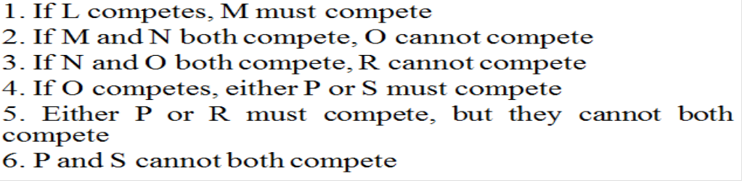
S No. 3
If O and R both compete in the track meet, which of the following cannot be true?
a) M competes
b) N competes: Correct due to 3
c) S competes: Eliminate due to 4
d) L does not compete
e) P does not compete: eleiminate due to 5

Slide 72
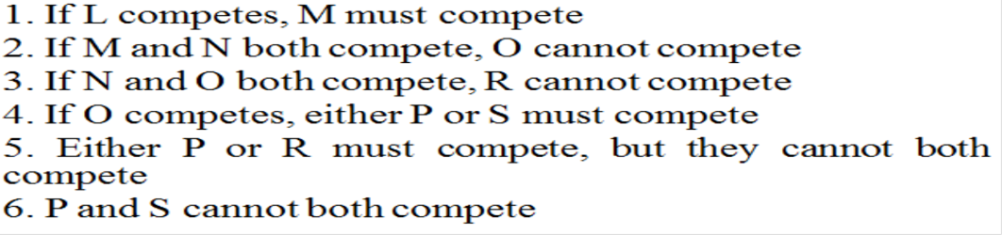
S.No.4
If L and N both compete in the track meet, what is the maximum number of athletes who can
compete
a) 3
b) 4: Correct as LMNR, LNOP, LNOS
c) 5:
d) 6
e) 7

Slide 73
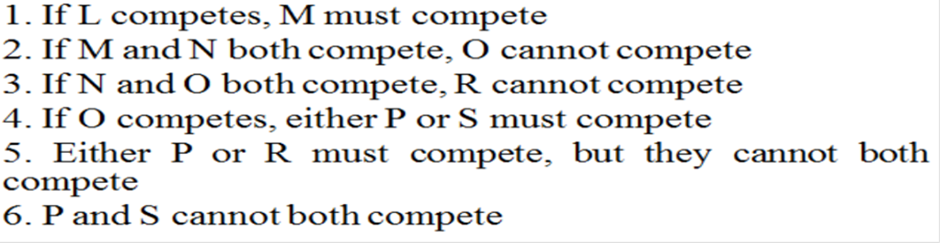
Solution
If S competes in the track meet, which of the following combinations of 3 athletes can be among
those who also compete?
a) LMP: Eliminate due to 6
b) LNO: Eliminate due to 1
c) LOP: Eliminate due to 6
d) MOR: Correct
e) NOR: Eliminate due to 3

Slide 74
Type V
Liar-Liar
These are games which contain statements by a few people, which are either true or false. From these statements, the student has to answer a few questions depending on the kind of condition given in the problem. This problem requires considerable amount of time and the student has to be ready to invest it during the exam. It may seem confounding in the beginning but once the thinking process is in
place and the approach methodical, it will appear simple.

Slide 75
Example Type V
Its time for the What-What island, where the inhabitants answer any question with two sentences; one of which is true and the other is false.
You are looking for Venkat’s house and you meet 3 people – Anand, Ravi and Som. You ask them, “Which is Venkat’s house?”
Anand says: Venkat’s house is No.9. I am his neighbour.
Ravi says: Anand is not my neighbour. Anand and som live in the same house.
Som says: Venkat’s house is not No.9. Anand is Ravi’s neighbour.
There are only two houses and four people in What-what. Two people live in each house.

Slide 76
Example Type V
Q1:From the above, you can decide that
a) Venkat stays in house no.9
b) Venkat does not stay in house no. 9
c) Venkat does not stay in what-what
d) Ravi and Som stay together.
Q2: Who stays with Anand?
a) Ravi
b) Venkat
c) Som
d) Cant say

Slide 77
Solution/Discussion
This question is very different from the previous ones and requires some time on the part of the student to understand and solve it.
A methodical process would be useful in this case. To begin with, start with the first speaker and label one sentence each as true or false, similarly for the other speakers.
Ascertain whether the labeling makes sense at the end of the third speaker.

Slide 78
Solution(cont)
For example, We label Anand’s first sentence as true (T) and the second as false (F) and similarly for Ravi’s and Som’s sentences.
The final output will look like:
Venkat’s house is no.9 and Anand is not his neighbour
Anand is not Ravi’s neighbour and Anand and som do not live in the same house.
Venkat’s house is not No.9 and Anand is not Ravi’s neighbour.
We can see the contradiction evident in the first and third sentences relating to Venkat’s house.
Since this doesn’t make much sense, we re-label the sentences accordingly, taking care of the initial contradiction.

Slide 79
Solution
If we label Anand’s first sentence as true, Som’s first sentence has to be false, and thereby Som’s
second sentence is true. This means that Anand is Ravi’s neighbour and therefore, Ravi’s first sentence is false.
Venkat’s house is no.9 and Anand is not his neighbour
Anand is not Ravi’s neighbour and Anand and som do not live in the same house.
Venkat’s house is No.9 and Anand is Ravi’s neighbour.
But here lies another contradiction – if Anand and Som live in the same house, then Ravi and Venkat live in the other house, but Anand;s second sentence specifically says that He is not Venkat’s neighbour. Therefore, even this is a wrong choice.

Slide 80
Solution
Now, we try the other way, by labeling Anand’s first sentence as false and Som’s first sentence as true. By the chain of thoughts, it is evident that Anand is not Ravi’s neighbour and therefore Anand and Ravi live in the same house, which is also true in case of the second sentence of Anand. Therefore, Venkat does not stay in House no. 9 and Ravi stays with Anand.
Venkat’s house is not no.9 and Anand is his neighbour
Anand is not Ravi’s neighbour and Anand and som do not live in the same house.
Venkat’s house is not No.9 and Anand is not Ravi’s neighbour.

Slide 81
Solution/Discussion (cont)
The result of above discussion can be summarized as below.
House A
Anound
Ravi
House B
Venkat
Som

Slide 82
Solution/Discussion (cont)
Q1:From the above, you can decide that
a) Venkat stays in house no.9
b) Venkat does not stay in house no. 9
c) Venkat does not stay in what-what
d) Ravi and Som stay together.
Q2: Who stays with Anand?
a) Ravi
b) Venkat
c) Som
d) Cant say

Slide 83
Type VI
Alpha Numeric
Here, numbers are coded as words or vice-versa and from the rules of this game, exact codes have to be identified.

Slide 84
Example Type VI
Two English words are codified as follows. Each number represents only one letter and each letter is
represented by only one number.
Word 1: 8 3 7 6 3 2 9
Word 2: 3 6 7 5 8 4 1 6
The following rules are known to the person decoding them.
I. Letters T and R occur exactly three times
II. Letters S and A occur exactly two times.
III. Letters E, P, O and N occur exactly once.
IV. One of the words starts with T and the other with S.
V. E occurs only in word 1.

Slide 85
Solution
We proceed methodically analyzing one condition at a time.
From the first condition, it is clear that T or R should stand for 3 or 6.
From the second condition, it is clear that S or A should stand for 8 or 7
We will ignore the third condition for sometime because we cannot conclude anything from it.
From the fourth condition, we can conclude that T stands for 3 and S stands for 8. Therefore, R stands for 6 and A stands for 7. E stands for either 2 or 9. O,P and n can be substituted for 5,4 and 1 in Word 2.

Slide 86
Solution/Discussion
Decoding the numbers individually, we find the following
Word 1: 8 3 7 6 3 2 9
S T ART
Word 2: 3 6 7 5 8 4 1 6
T RA S R
In this particular question, the words are not those that make some meaning. Its more open-ended than a word that has a meaning attached to it.
I say so because it is not possible to decipher all the numbers correctly, and therefore, its left to the student as to what he makes of the numbers and words which cannot be correctly identified.

Slide 87
Type VII
Absolute Relatives:
In this game, again a variant of the first 2 games, from the data given, relationships have to be identified.

Slide 88
Example Type VII
A, B, C, D, E, F, G and H are people who are related as below
I. A is the father of 2 children C (male) and D (female)
II. H is the mother of two children E (male) and F (female)
III. B is E’s mother-in-law
IV. D is the daughter-in-law
V. E’s wife is F’s sister-in-law
VI. E’s son will also be A’s grandson and C’s daughter will also be H’s grand-daughter

Slide 89
Example Type VII
Q1. Who is A’s wife?
a) H
b) F
c) B
d) E
e) NONE OF THESE
Q2. Who is H’s husband?
a) B
b) A
c) D
d) F
e) NONE OF THESE

Slide 90
Example Type VII
Q3. Who is D’s mother-in-law?
a) B
b) H
c) F
d) E
e) NONE OF THESE
Q4. A’s daughter will also be
A. B’s daughter in law
B. E’s wife
C. H’s daughter
a) A only
b) B only
c) C only
d) A and B only
e) B and C

Slide 91
Example Type VII
Q5. D is
a) Wife of A
b) Wife to E
c) Daughter of G
d) F’s sister
e) None of these
Q6. E’s mother is also
a) D’s mother
b) C’s grandmother
c) B’s sister
d) G’s wife
e) A’s wife

Slide 92
Example Type VII
Q7. If X is C’s son and Y is E’s daughter then X and Y must be
a) Brother & Sister
b) Husband and Wife
c) D’s children
d) H’s grand children
e) None of these
Q8. Out of 8 people, how many must be male?
a) 4
b) 3
c) 5
d) 2
e) 6

Slide 93
Example Type VII
Q9. Out of 8 people, how many must be female?
a) 2
b) 3
c) 4
d) 5
e) 6
Q10. Which of the following represent a correct pair of husband and wife?
a) A&H
b) B&G
c) E&D
d) A&F
e) C&D

Slide 94
Solution/Discussion
How better to solve a family problem than by using a family tree. We can use symbols to denote the different relationships. Males and Females can be denoted using m and f respectively.

Slide 95
Solution/Discussion (cont)
The following symbols can be used: (Indicative symbols)
Father: up-arrow
Mother: up-arrow
Mother-in-law: diagonal up arrow
Father-in-law: diagonal up arrow
Daughter-in-law: diagonal down arrow
Son: down-arrow
Daughter: down-arrow

Slide 96
Solution/Discussion (cont)
Using the conditions given above, the relationships can be symbolized as follows:

Slide 97
Solution/Discussion (cont)
From the symbols above, we can infer the following:
Since A has 2 children, C & D, E must be the son-in-law.
Since H has 2 children, E & F, C must be the daughter-in-law (which is also mentioned in the
conditions)
E’s wife therefore is D, who is the brother of C, who is F’s husband.
Since G is the only missing link, G must be the husband of H, just as B is the wife of A
The families are : AB, GH, ED and CF. There are an equal number of males and females in the family.
Therefore, X and Y are the grand-children of AB and GH. The other questions can be solved similarly.

Slide 98
Solution/Discussion (cont)
Q1. Who is A’s wife?
a) H
b) F
c) B
d) E
e) NONE OF THESE
Q2. Who is H’s husband?
a) B
b) A
c) D
d) F
e) NONE OF THESE

Slide 99
Solution/Discussion (cont)
Q3. Who is D’s mother-in-law?
a) B
b) H
c) F
d) E
e) NONE OF THESE
Q4. A’s daughter will also be
A. B’s daughter in law
B. E’s wife
C. H’s daughter
a) A only
b) B only
c) C only
d) A and B only
e) B and C

Slide 100
Solution/Discussion (cont)
Q5. D is
a) Wife of A
b) Wife to E
c) Daughter of G
d) F’s sister
e) None of these
Q6. E’s mother is also
a) D’s mother
b) C’s grandmother
c) B’s sister
d) G’s wife
e) A’s wife

Slide 101
Solution/Discussion (cont)
Q7. If X is C’s son and Y is E’s daughter then X and Y must be
a) Brother & Sister
b) Husband and Wife
c) D’s children
d) H’s grand children
e) None of these
Q8. Out of 8 people, how many must be male?
a) 4
b) 3
c) 5
d) 2
e) 6

Slide 102
Solution/Discussion (cont)
Q9. Out of 8 people, how many must be female?
a) 2
b) 3
c) 4
d) 5
e) 6
Q10. Which of the following represent a correct pair of husband and wife?
a) A&H
b) B&G
c) E&D
d) A&F
e) C&D

Slide 103
Type VIII
Map Game
These types of games describe connection between the elements specified in the game. Symbols are very much useful in this type of games.

Slide 104
Example Type VIII
In a message relay system there are exactly seven terminals – F,G,H,J,K,L and M. A terminal can transmit any messages initiated by that terminal as well as any messages received from others, but only according to specific rules:
Messages can be transmitted in either direction between G and H, in either direction between J and M, and in either direction between K and L.
Messages can be transmitted from F to K, from H to J, from K to G, From M to F, and from M to H.

Slide 105
Example Type VIII
Q1. Which of the seven terminals can transmit messages directly to the greatest number of
terminals?
a) F b) H c) J d) K e) M
Q2. If a message initiated by G is to reach K, and is to be transmitted to no more terminals than
necessary, it must be transmitted to a total of how many terminals, other than G and K?
a) 1 b) 2 c) 3 d) 4 e) 5
Q3. A message from H that eventually reaches L must have been transmitted to all of the following
terminals except
a) F b) G c) J d) K e) M

Slide 106
Example Type VIII
Q4. If J is removed from the message relay system for a day, it is still possible for a message to be
transmitted on that day all the way along a route from
a) F to H b) G to K c) G to M d) H to K e) L to M
Q5. If K is removed from the message relay system for a day, which of the following terminals
cannot receive any messages from any other terminal on that day
a) F b) G c) H d) J e) L

Slide 107
Solution & Discussion
Arrows can be used to show the connection between the different elements. One-way or Two-way arrows can be used to differentiate between the connections.

Slide 108
Solution/discussion (cont)
Using these connections, we make a link connecting these elements.

Slide 109
Solution/discussion (cont)
With this combined map, we can proceed to answering the questions. The process of elimination can also be used in this case. If there arises a need to redraw the “connection” chart for a particular question, go ahead and do it.

Slide 110
Solution/discussion (cont)
Q1. Which of the seven terminals can transmit messages directly to the greatest number of
terminals?
a) F b) H c) J d) K e) M

Slide 111
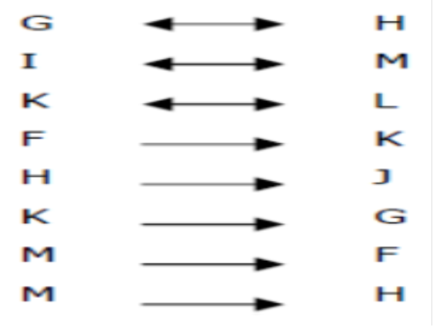
Solution/discussion (cont)
Q2. If a message initiated by G is to reach K, and is to be transmitted to no more terminals than
necessary, it must be transmitted to a total of how many terminals, other than G and K?
1 b) 2 c) 3 d) 4 e) 5
G to H to J to M to F to K

Slide 112
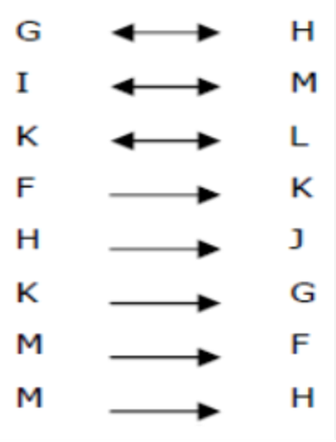
Solution/discussion (cont)
Q3. A message from H that eventually reaches L must have been transmitted to all of the following terminals except
a) F b) G c) J d) K e) M

Slide 113
Solution/discussion (cont)
Q4. If J is removed from the message relay system for a day, it is still possible for a message to be transmitted on that day all the way along a route from
a) F to H b) G to K c) G to M d) H to K e) L to M

Slide 114
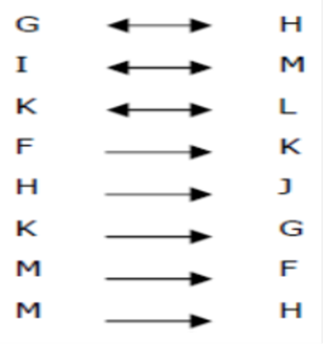
Solution/discussion (cont)
Q5. If K is removed from the message relay system for a day, which of the following terminals cannot receive any messages from any other terminal on that day
a) F b) G c) H d) J e) L

